Slide 1

Arc Shift Solution Type: Prototype
Workshop Content
Ramprakash R
Lenny Dany Derek D
Adorn S George
Sidhanth Bibi
Arindam Jaiman
Notes:
Korrie

Slide 2
Student Ambassador Projects
IELTS Prep Gap: Students lack personalized, real-time feedback in current IELTS tools.
Challenge: Static practice materials fail to adapt to learners’ strengths and weaknesses.
Our Angle: Build an AI-first learning assistant that ensures:
Accurate band score prediction.
Actionable feedback (strengths, weaknesses, suggestions).
Continuous progress tracking across Speaking, Writing, Reading, and Listening.
Vision: Democratize IELTS preparation with accessible, cloud-based, AI-driven learning.
Notes:
Korrie

Slide 3
The Opportunity
1. Industry Trends & Pain Points
2. Why big companies should care
3. How we disrupt & inspire
Explosion of IELTS demand: Millions of students across Asia, Africa, and beyond attempt IELTS every year to pursue higher studies or immigration.
Status quo problem: Current prep solutions are static – mock books, PDFs, or rigid apps that give the same material to everyone.
Pain point: Students waste time and money preparing without truly knowing their weaknesses. Traditional coaching centers offer generic feedback, not personalized guidance.
Hidden issue: Many learners don’t realize that not tracking progress systematically leads to repeated mistakes, plateaued improvement, and ultimately, lower band scores.
Missed opportunity: Global EdTech giants are focused on mass distribution but not personalization.
Our edge as a startup: We are lean, innovative, and closer to the ground reality. We can rapidly build and test disruptive AI-first tools that address real user struggles that big firms may overlook.
Value to them: Partnering with us gives them an innovation pipeline—they can integrate our AI-driven insights into their ecosystem, improving retention and satisfaction.
Empathy: We put ourselves in the learner’s shoes—nervous before the exam, unsure where to improve, frustrated by vague “band 6.5” results.
Education: Instead of generic scores, our platform explains why a student lost points, and how to fix it—like a personal AI coach available 24/7.
Inspiration: Students don’t just practice—they see their growth on dashboards, track trends, and feel motivated to push further.
4. Opportunity Story (Paint the picture)
Imagine a student in a Tier-2 Indian city. She can’t afford expensive tutors but dreams of studying abroad.
Today: She buys test books, watches random YouTube videos, and still feels lost.
With us: She logs in, practices speaking → AI transcribes, scores, and explains. She writes an essay → AI pinpoints grammar issues. Her dashboard shows she’s moving from Band 6.0 to 7.5 over a month.
That journey—accessible, affordable, and guided—is the game-changing opportunity.
5. Key Message for Slide
IELTS prep = broken & static.
Learners lack real-time, adaptive feedback.
Our AI-first platform personalizes the journey.
Huge opportunity to democratize global education.
Notes:
Korrie
updated 7/21

Slide 4
Solution
Why we built it
How we address pain points & opportunities
What sets us apart (vs. big, served market)
Speaking: ASR → AI scoring with strengths/weaknesses & suggestions.
Writing (Essay): Band by criteria (TR/CC/LR/GRA) + detailed fixes.
Listening/Reading: Randomized sets, auto-eval, explanations, saved scores.
Progress: Saved to Supabase; dashboard shows overall band & trends.
Unlike generic prep apps and video courses, we deliver instant band scores with pinpointed, criteria-level guidance and persistent analytics, not just practice banks.
Time-to-value: no tutor scheduling; insights in seconds, stored to the cloud for continuous improvement.
IELTS prep is static, not personal; learners don’t know why they lose marks or how to improve fast. We built an AI coach that scores and explains across all four sections with progress tracking.
What it is / Where we fit
Compelling customer examples (personas)
Call-to-action / next
Category: AI-first, personalized IELTS preparation—automated scoring + actionable feedback + analytics, delivered via cloud. 1-Month Progress Report – IELTS…
Stack: Next.js + FastAPI + Supabase + Azure AI (GPT-4, GPT-4o Transcribe, TTS).
Self-study candidate: Uses Speaking + Essay nightly; sees band rise via trend dashboard and targeted tips.
Working professional: Short Listening/Reading drills at lunch; auto-evaluation and explanations keep momentum.
Rolling out timed simulations, Study Planner AI, richer analytics, mobile UX next month.
Notes:
Korrie
updated 7/21

Slide 5
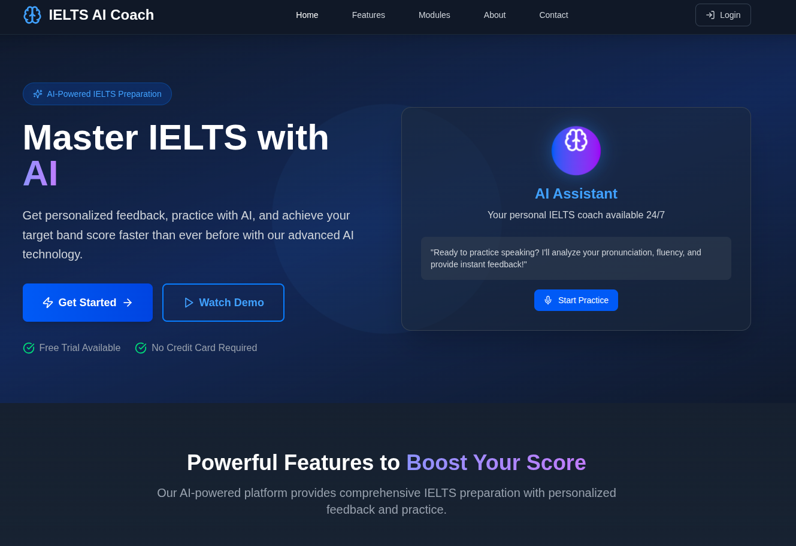
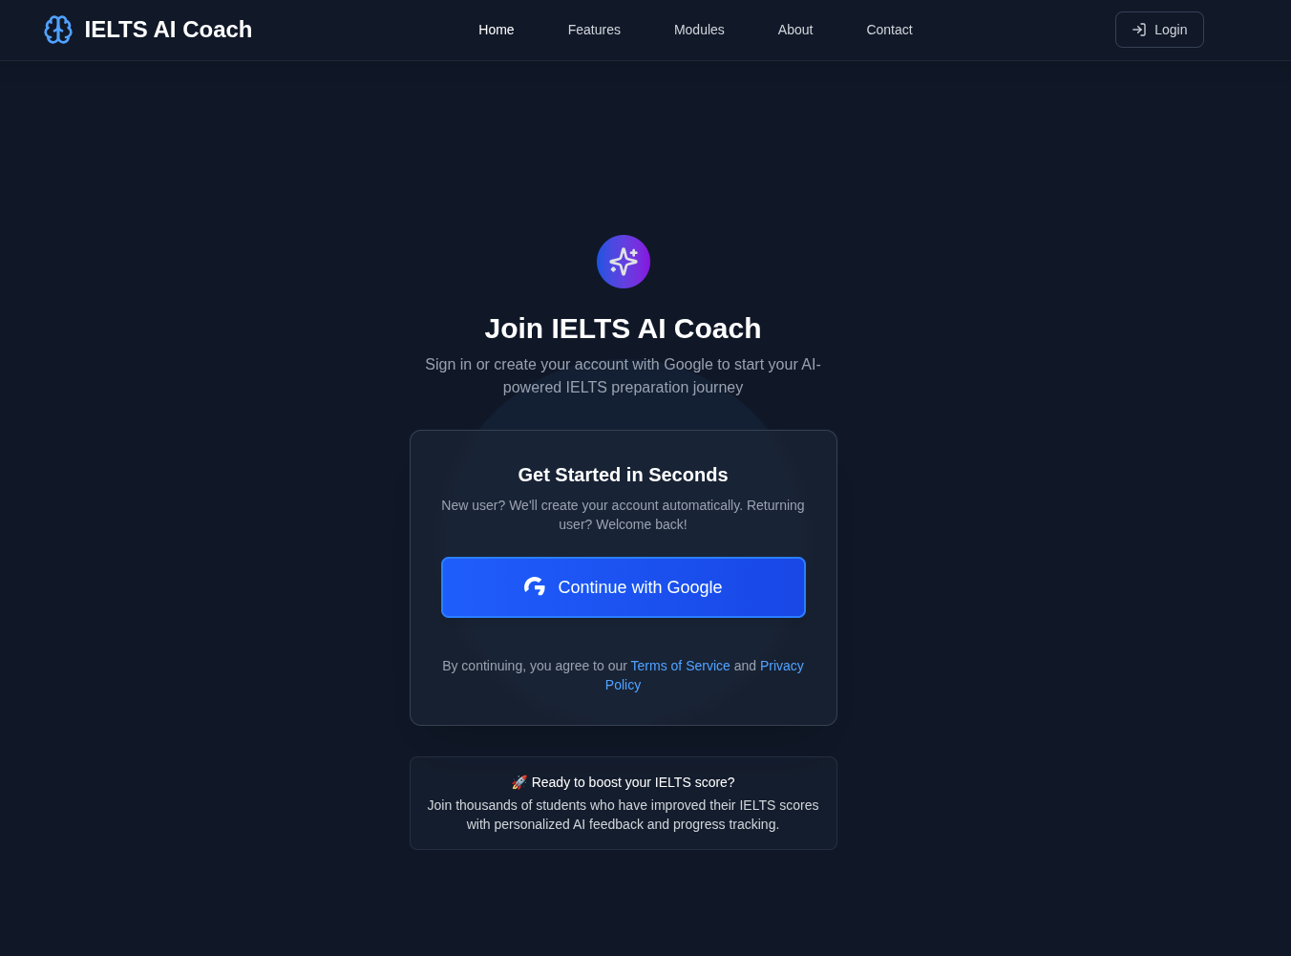
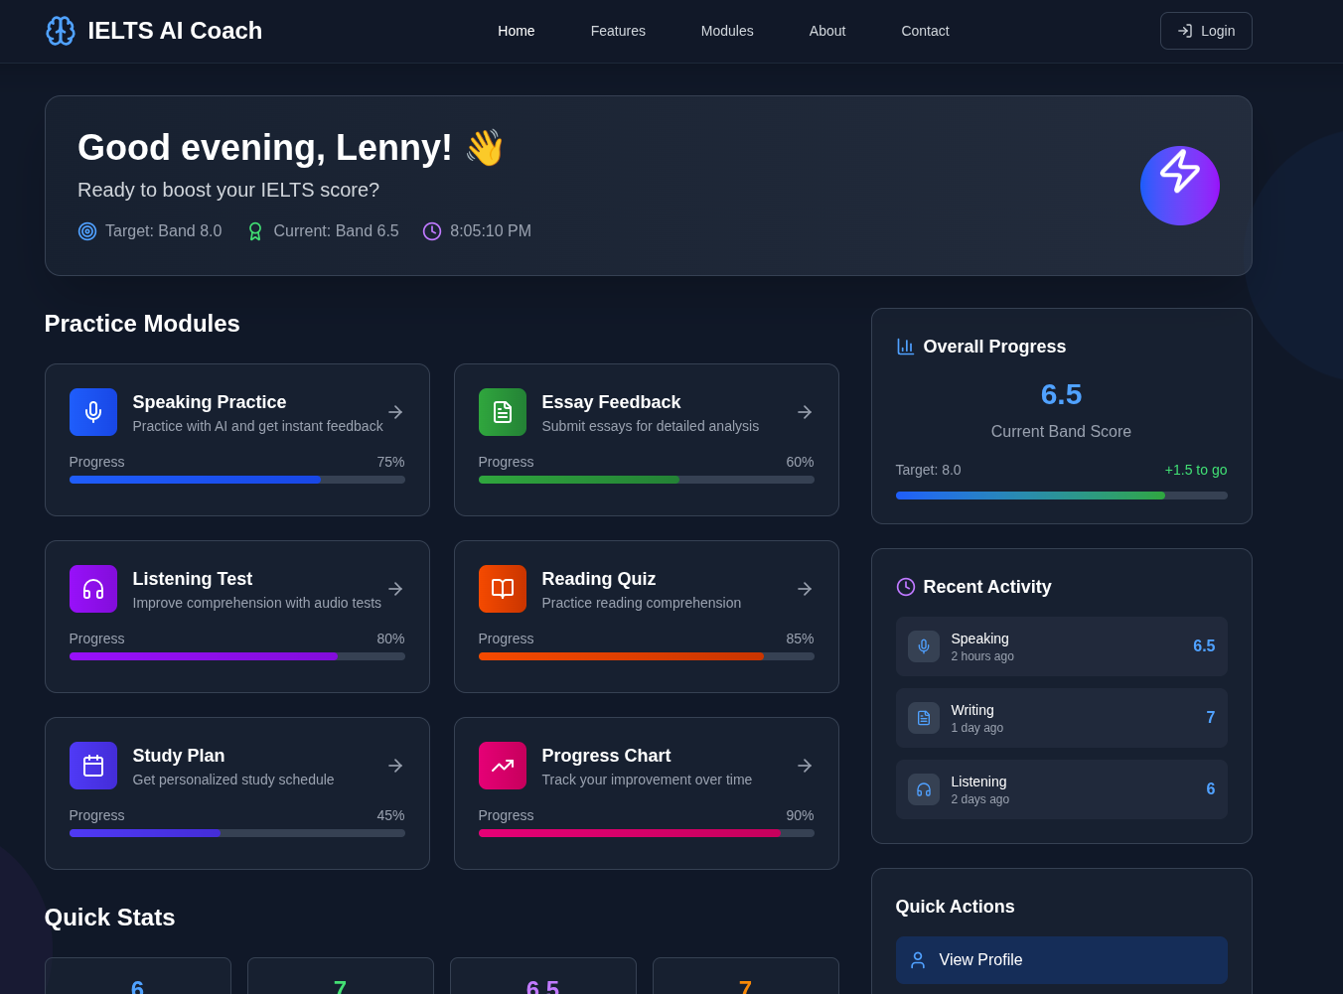
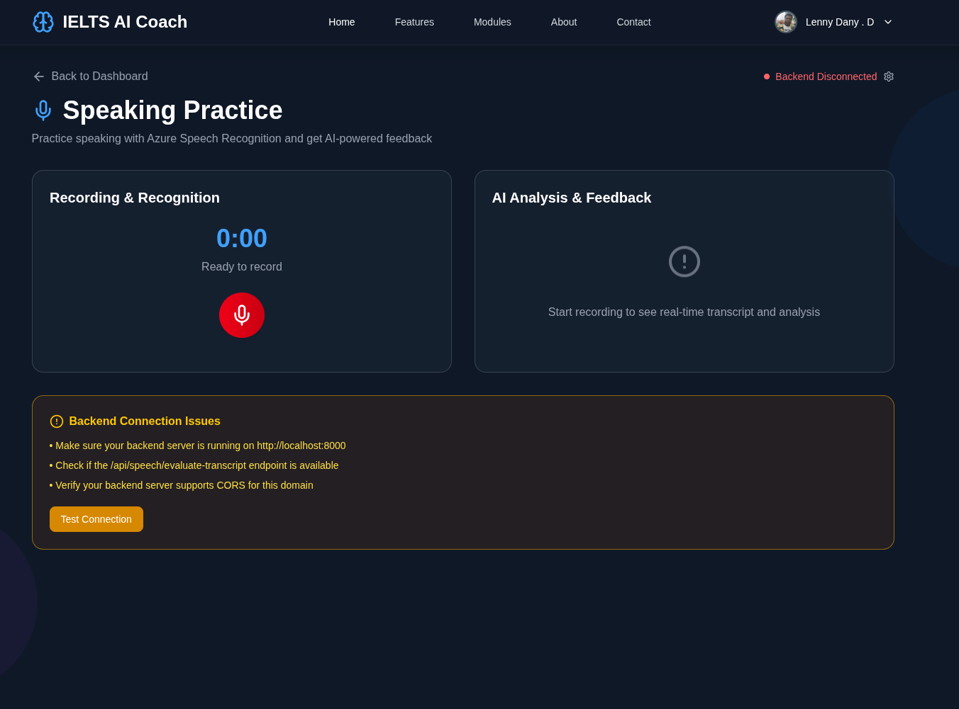
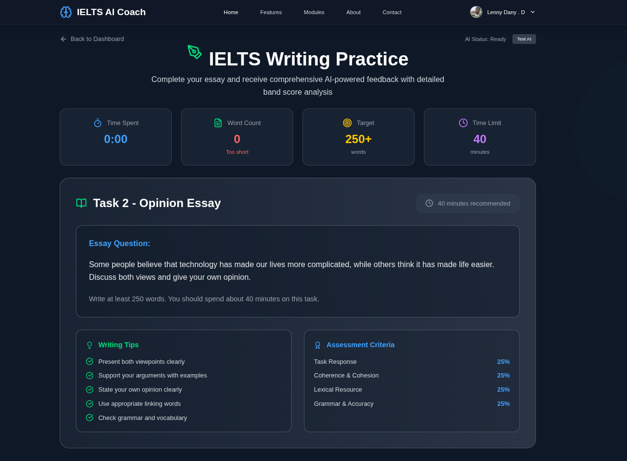
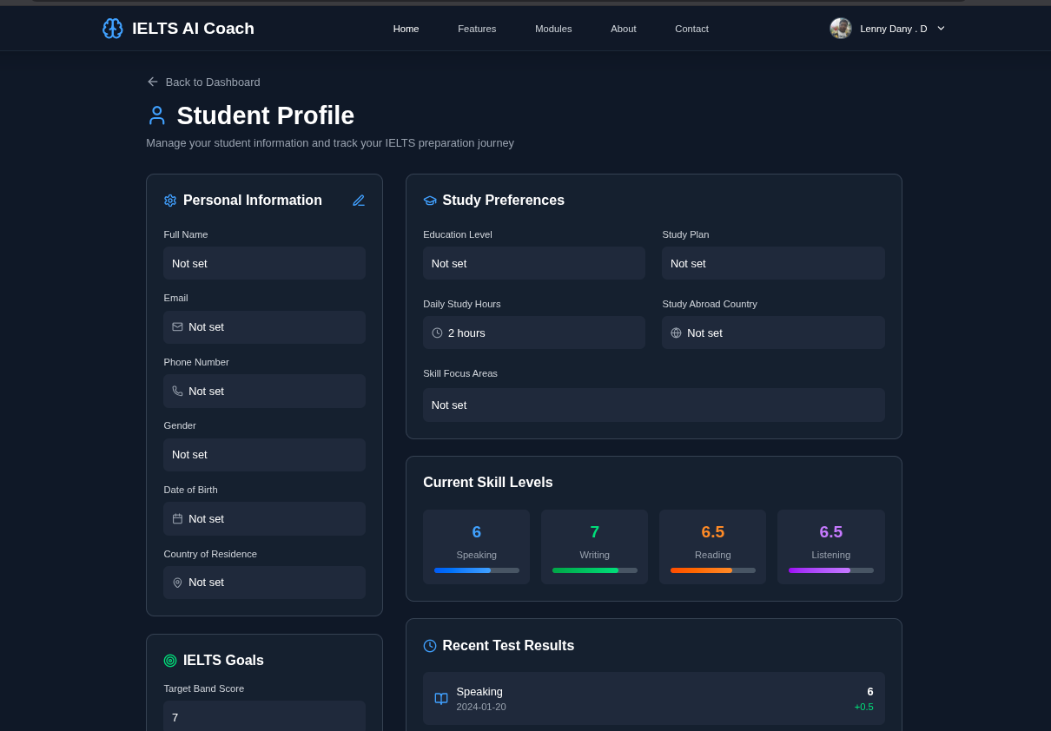
Demo
Website : https://ielts-project-gilt.vercel.app
Demo Video: Video Link
Home Page
Login Page
Dashboard
Listening Practices
Essay Writting
Student Progress
Notes:
Korrie
updated 7/21

Slide 6
Takeaways
Wrap it up — What to do next
Stop: using static books/courses that don’t give personalized feedback.
Start: practicing with AI-scored Speaking/Writing and auto-evaluated Reading/Listening, with results saved to your dashboard.
Without us, you can: take mock tests and watch tips videos — but you’ll still lack criteria-level feedback and trend tracking.
Faster: instant band scores + actionable fixes after every attempt.
Simpler: one login; all scores saved; clear progress and trend charts.
Cheaper: scalable AI coaching reduces ongoing tutor time and costs.
Notes:
Korrie
updated 7/21

